Slide 1
Expanding Customer Relationships

Slide 2
Learning Objectives
Explain how to follow-up to assess customer satisfaction
Explain how to harness technology to enhance follow-up and buyer-seller relationships
Discuss how to take action to ensure customer satisfaction
Discuss how to expand collaborative involvement
Explain how to add value and enhance mutual opportunities

Slide 3
Ways to Establish Customer Relationship
Build goodwill: Convert new customers into lifetime customers by continually adding value to the product
Handle complaints in a timely and thoughtful manner
Process requests for rush deliveries willingly
Assure the customer that the salesperson will do everything possible to make that request happen

Slide 4
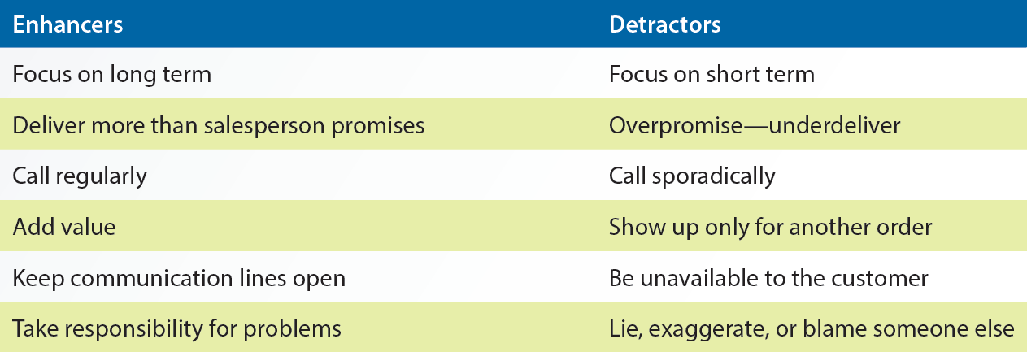
9.1 Relationship Enhancers and Detractors

Slide 5
Customer Satisfaction
Ensures customer trust
Salespeople should:
Perform post-sale follow-up activities
Anticipate and adapt to changes in situations
Regularly provide product information
Gather customer satisfaction information through surveys, feedbacks, and social media

Slide 6
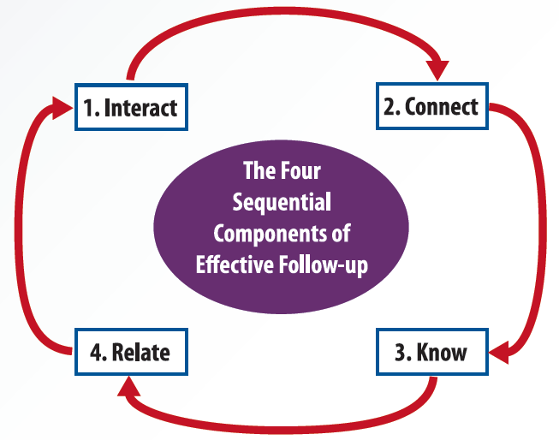
9.2 The Four Sequential Components of Effective Follow-up

Slide 7
Salesforce Automation Tools
PC based applications
Maximizer
ACT
Goldmine
Internet-based applications
Salesforce
Netsuite

Slide 8
Harnessing Technology to Enhance Follow-up and Buyer-Seller Relationships
Customer contact management tools are used in multiorganization intranets and extranets
Intranet: Organization’s computer network that offers password-controlled access to people within and outside
Extranet: Computer network created by an organization for use by its customers or suppliers
Linked to the organization’s internal systems, informational databases, and intranet

Slide 9
Harnessing Technology to Enhance Follow-up and Buyer-Seller Relationships (continued)
Customer relationship management systems (CRM)
Links buyers and sellers into a rich communication network
Establishes and reinforces long-term, profitable relationships

Slide 10
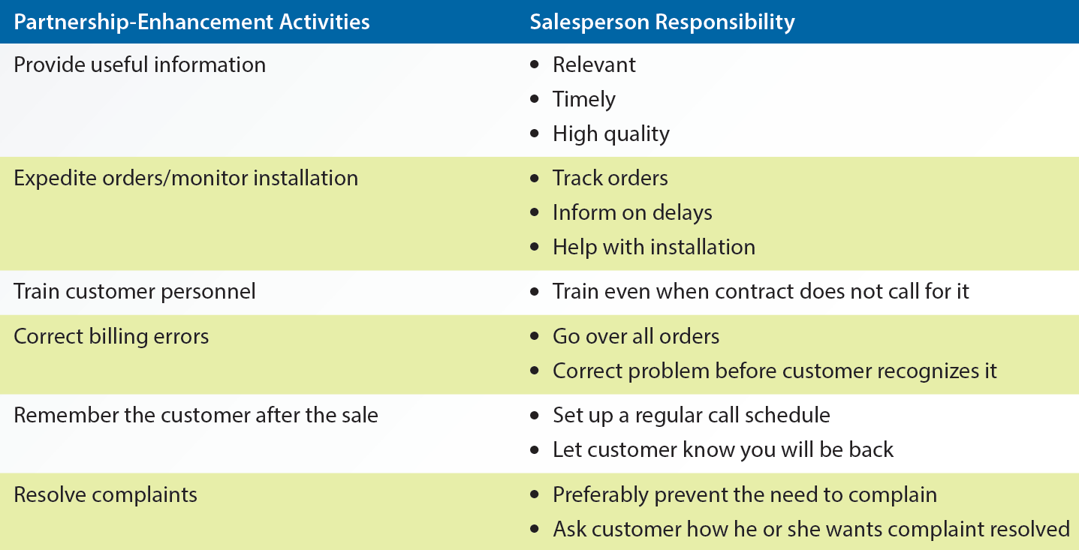
9.3 Relationship Enhancement Activities

Slide 11
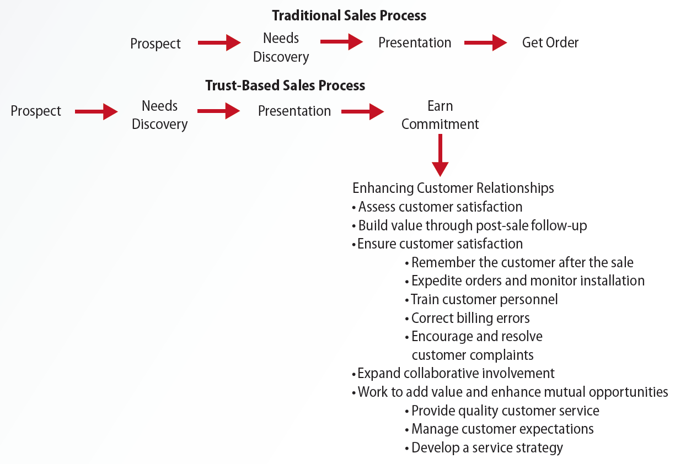
9.3 Traditional versus Relational Sales Process

Slide 12
Ethical Dilemma

Slide 13
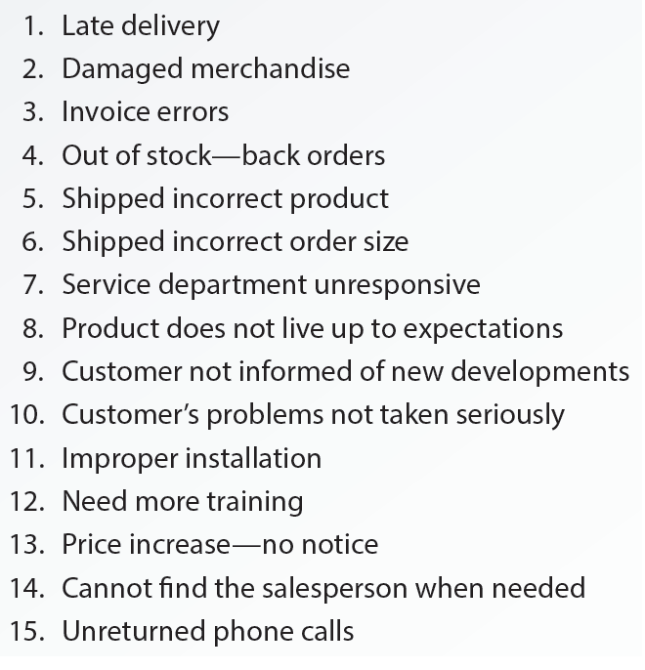
9.5 Typical Customer Complaints

Slide 14
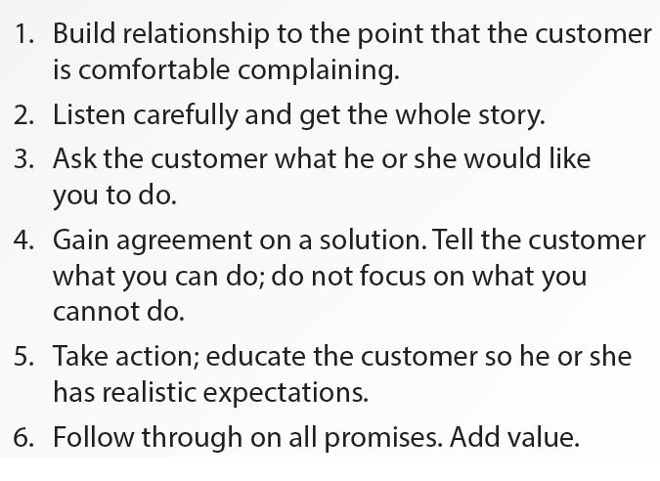
9.6 General Procedures for Handling Complaints

Slide 15
Collaborative Involvement
Process in which the buyer’s organization and the salesperson’s organization combine to improve an offering
Customers can provide insight on how products can be improved
Companies can hold training sessions, seminars, and social engagement workshops for its customers

Slide 16
Adding Value and Enhancing Mutual Opportunities for the Customer
Provide quality customer service
Meet customer expectations
Develop a service strategy
Concentrate on the dimensions of customer service

Slide 17
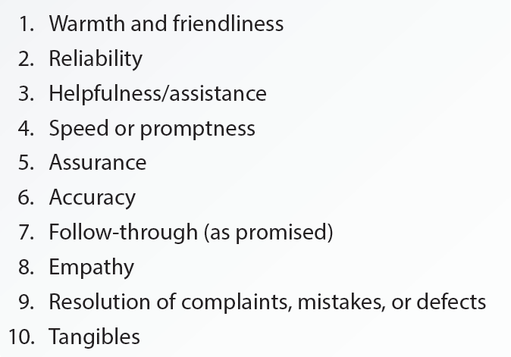
9.8 Customer Expectations of Salespeople

Slide 18
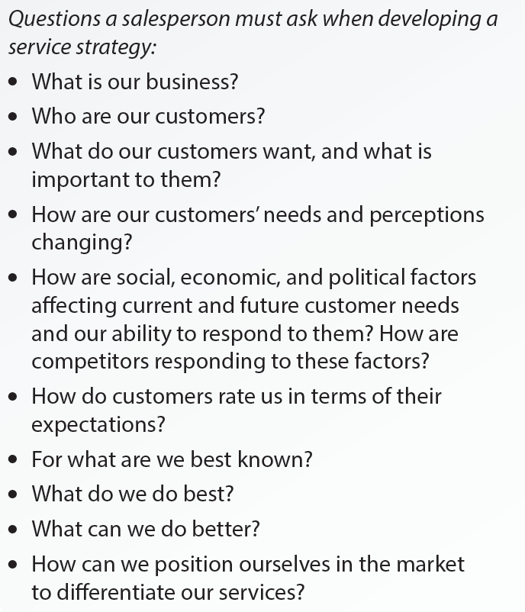
9.9 Checklist for Developing a Service Strategy

Slide 19
Customer Service Dimensions
Communication
Service motivation
Two-way flow of information between salesperson and customer
Customer Service Dimensions
Desire of a salesperson to serve customers each day
Resilience
Salesperson’s ability to withstand customer’s verbal assault and get right back up with a smile and ask for more

Slide 20
Key Terms
Building goodwill
Adding value
Interact
Connect
Know
Relate
Intranet
Extranet
Customer relationship management (CRM) system
Critical encounters
Collaborative involvement
Service quality
Service strategy
Communication
Resilience
Service motivation

Slide 21
Summary
Building goodwill and adding value to the product or service through regular follow-up enhances customer relationship
Components of effective follow up
Interact, connect, know, and relate
Relationship-enhancement activities are critical to the success of building long-term relationships
Salespeople should always look for ways to improve the relationship and create a stronger bond

