Slide 1
Addressing Concerns and Earning Commitment

Slide 2
Learning Objectives
Explain why it is important to anticipate and overcome buyer concerns and resistance
Understand why prospects raise objections
Describe the five major types of sales resistance
Explain how the LAARC method can be used to overcome buyer resistance
Describe the recommended approaches for responding to buyer objections
List and explain the earning commitment techniques that secure commitment and closing

Slide 3
Sales Resistance
Buyer’s objections to a product or service during a sales presentation
Viewed as opportunities to sell
Normal part of a sales conversation
Salesperson will have to:
Determine customer interest
Measure the buyer’s understanding of the problem
Correct handling ensures customer acceptance

Slide 4
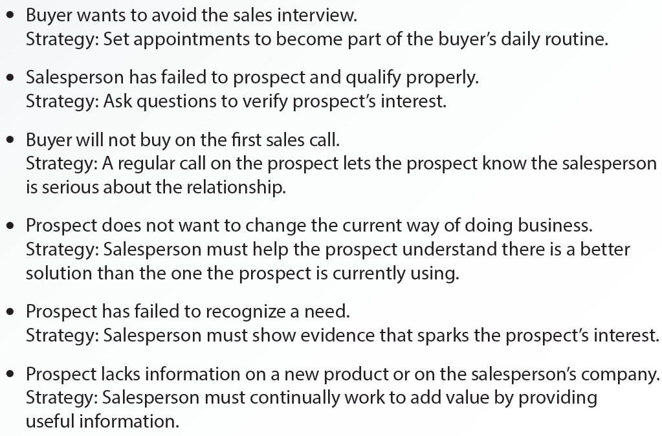
8.1 Why Prospects Raise Objections and Strategies for Dealing with Them

Slide 5
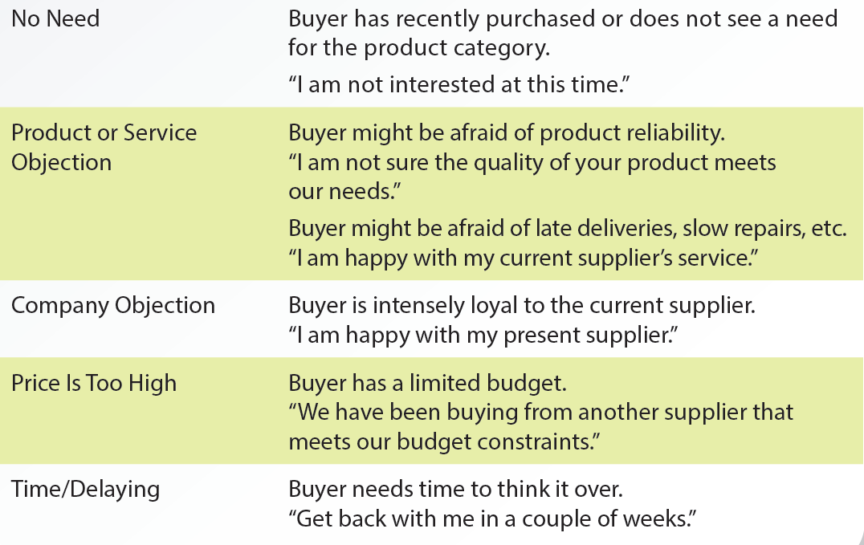
8.2 Types of Objections

Slide 6
Negotiating Buyer Resistance - LAARC
Listen
Acknowledge
Assess
Respond
Confirm

Slide 7
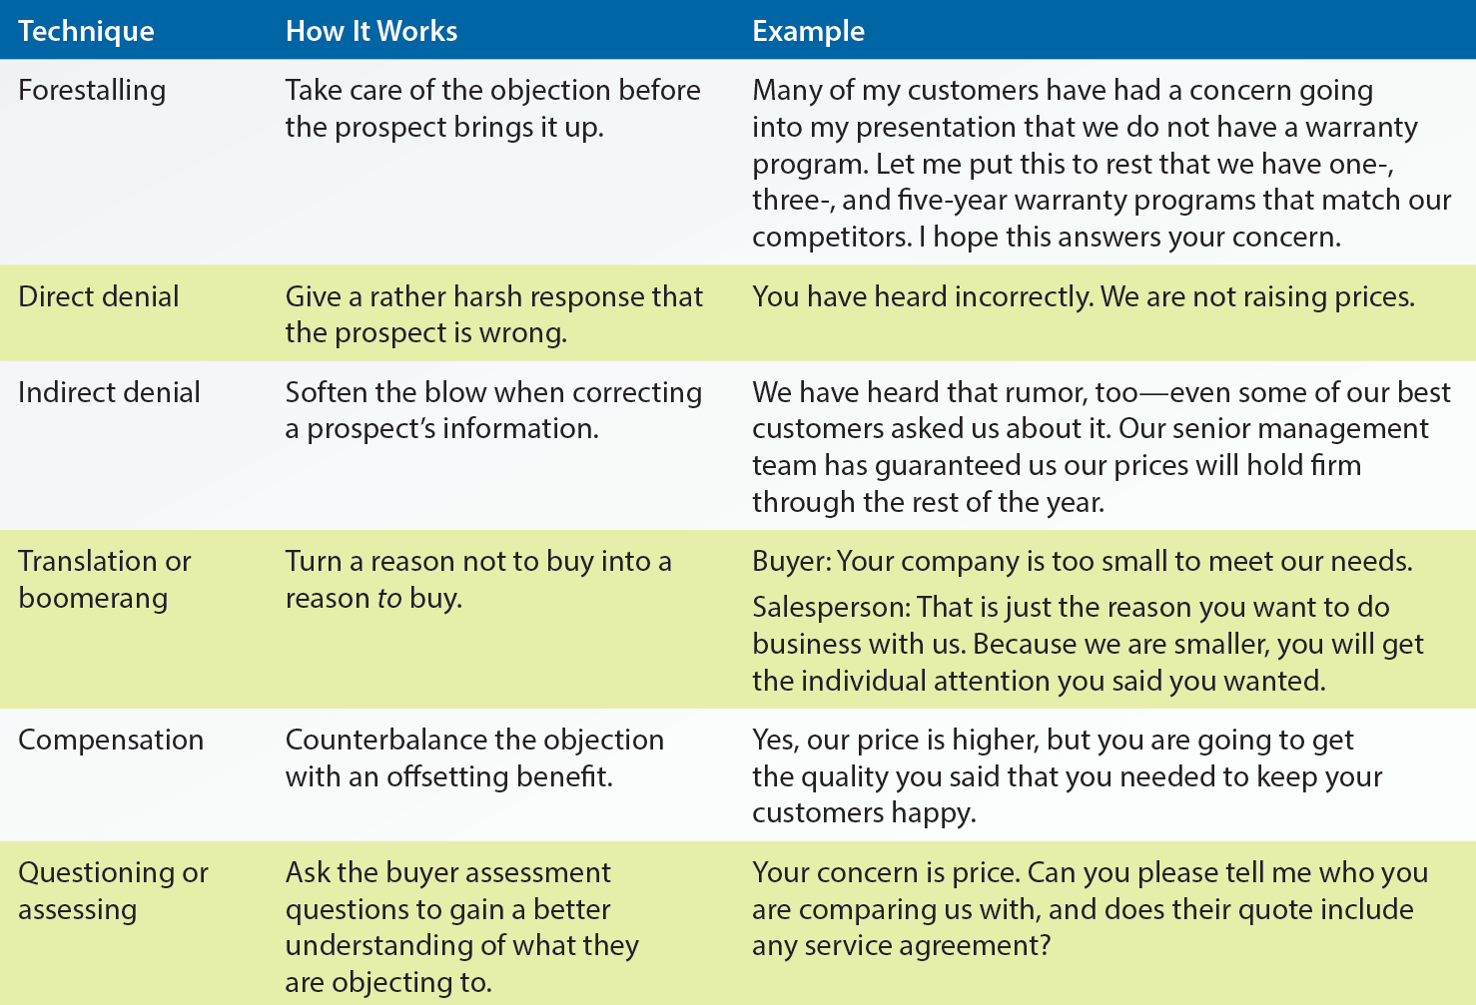
8.8 Techniques to Answer Sales Resistance

Slide 8
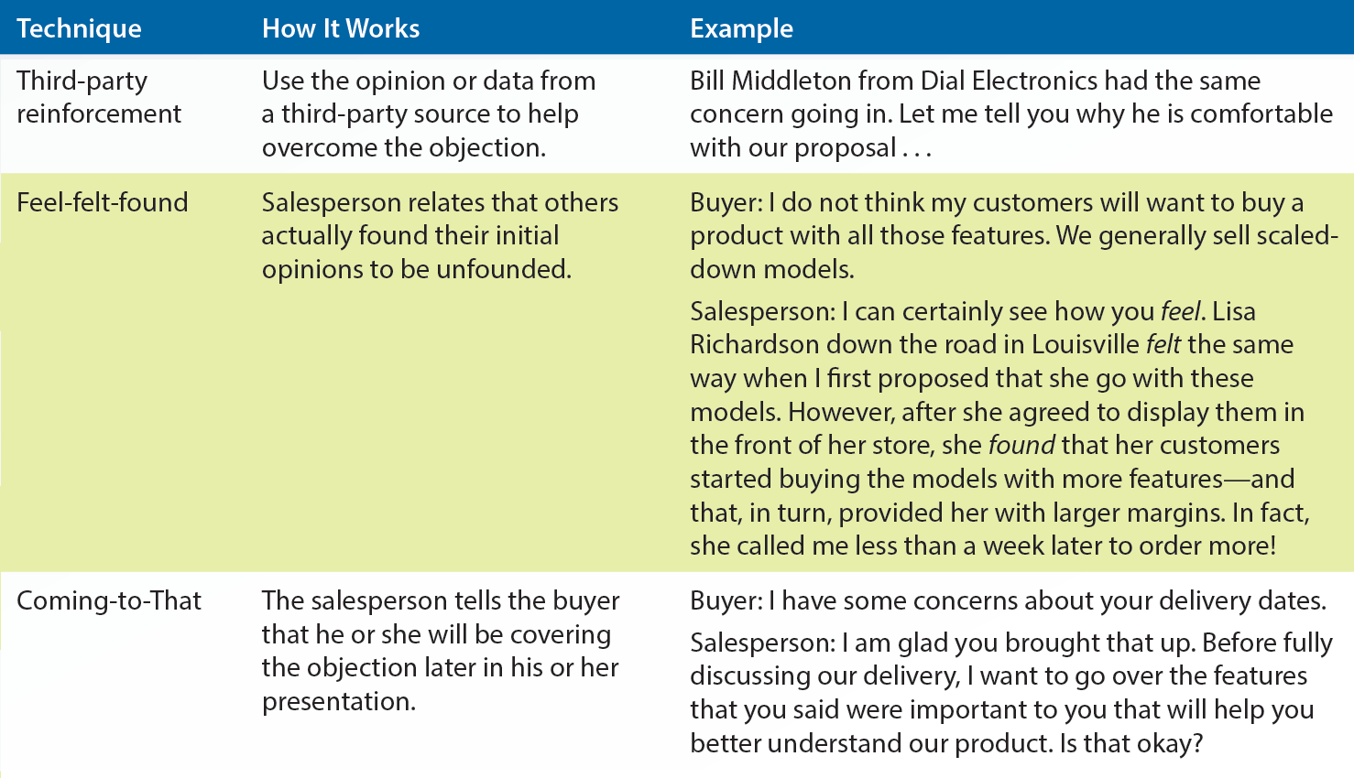
8.8 Techniques to Answer Sales Resistance (continued)

Slide 9
Securing Commitment and Closing
Salesperson should allow the prospect to make a rational choice by giving him/her enough mental space
Commitment signals: Favorable statements a buyer makes during a sales presentation that signals buyer commitment
May be determined through the use of trial commitments
Trial commitment: Determines the attitude of the buyer toward a particular feature or benefit

Slide 10
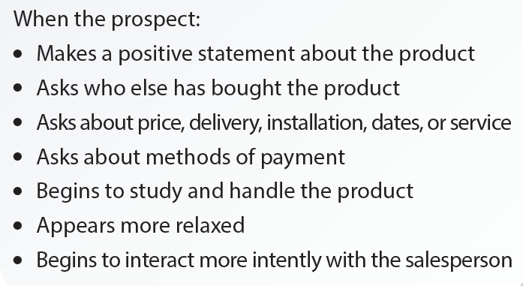
8.10 Favorable Buying Signals

Slide 11
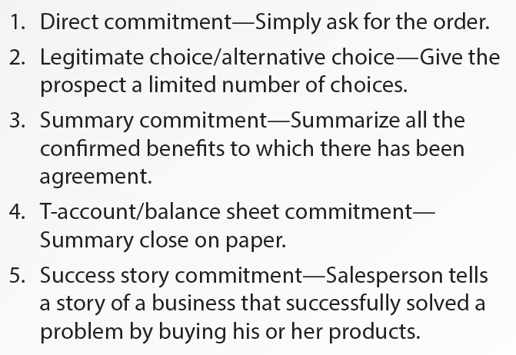
8.12 Techniques to Earn Commitment

Slide 12
8.13 Traditional Commitment Method

Slide 13
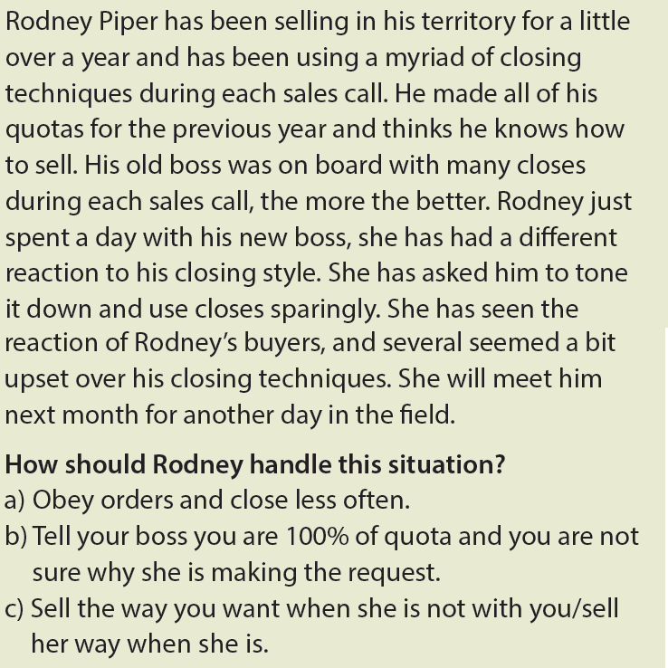
Ethical Dilemma

Slide 14
Key Terms
Sales resistance
Need objection
Product or service objection
Company or source objection
Price objection
Time objection
LAARC
Forestalling
Direct denial
Indirect denial
Translation or boomerang
Compensation
Questions or assess
Third-party reinforcement

Slide 15
Key Terms (continued 1)
Commitment signals
Trial commitment
Direct commitment
Alternative/ legitimate choice
Summary commitment
T-account or balance sheet commitment
Success story commitment
Standing-room only close
Assumptive close
Fear or emotional close
Continuous yes close
Minor-points close

Slide 16
Summary
Over the years, sales resistance has been viewed as opportunities to sell
Types of objections from the buyer
Need, product or service, company or source, price, and time
LAARC is an effective process for salespeople to overcome sales resistance
Earning or gaining commitment is the final aspect of the selling process

