Slide 1
Planning Sales Dialogues and Presentations
Copyright ©2017 Cengage Learning. All Rights Reserved. May not be scanned, copied or duplicated, or posted to a publicly accessible website, in whole or in part.

Slide 2
Learning Objectives
Explain why it is essential to focus on the customer when planning sales calls
Understand alternative ways of communicating with prospects and customers through canned sales presentations, written sales proposals, and organized sales dialogues or presentations
Discuss the nine components in the sales dialogue template that can be used for planning an organized sales dialogue or presentation

Slide 3
Learning Objectives (continued)
Explain how to write a customer value proposition statement
Link buying motives to benefits of the seller’s offering, support claims made for benefits, and reinforce verbal claims made
Engage the customer by setting appointments

Slide 4
Customer-Focused Sales Dialogue Planning
Sales call: In-person meeting between the buyer and the salesteam
Sales dialogue: Business conversations between buyer and salesperson to initiate, develop, and enhance customer relationships
Sales presentations: Comprehensive
communications
designed to persuade the customer to make a purchase

Slide 5
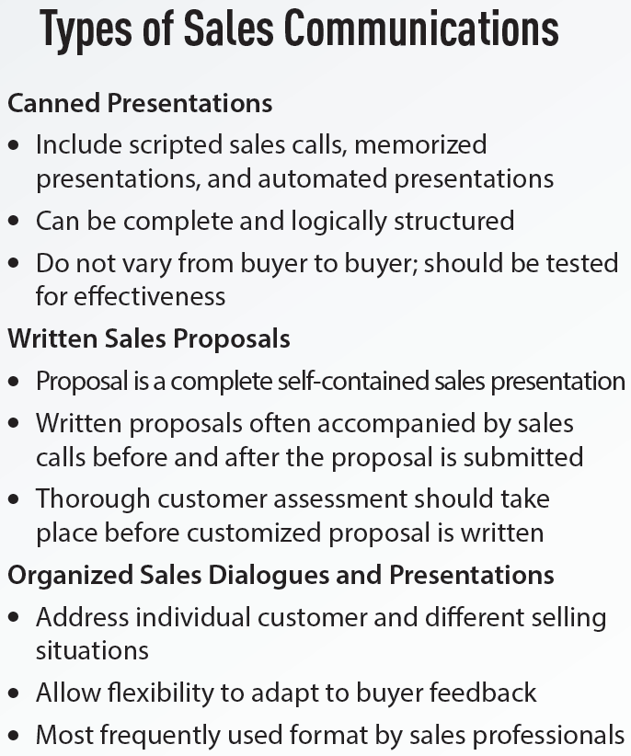
6.1 Types of Sales Communications

Slide 6
Parts of a Sales Proposal
Executive summary
Functions - Demonstrates salesperson’s knowledge about the customer’s need and creates a desire in the customer to read it
Customer needs and proposed solution
Includes situation analysis and the recommended solution

Slide 7
Parts of a Sales Proposal (continued)
Seller profile
Information about the selling company
Pricing and sales agreement
Presents the pricing and delivery options
Implementation and timetable
Includes details about the additional information required to sign the contract

Slide 8
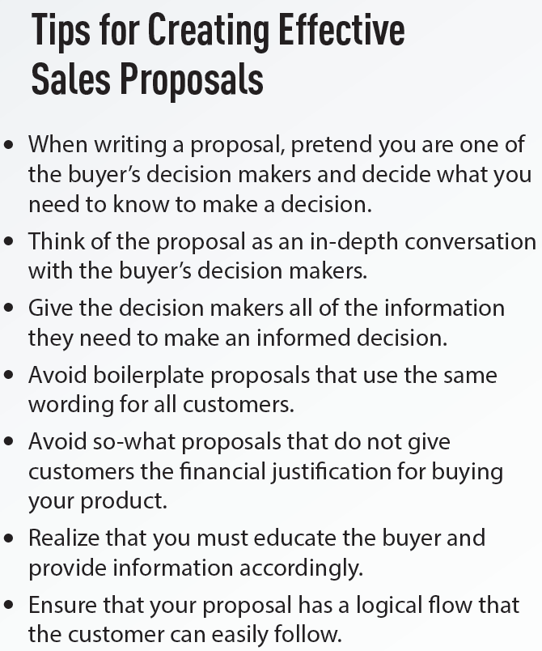
6.2 Tips for Creating Effective Sales Proposals

Slide 9
Dimensions for Evaluating Sales Proposals
Reliability
Assurances
Tangibles
Empathy
Responses

Slide 10
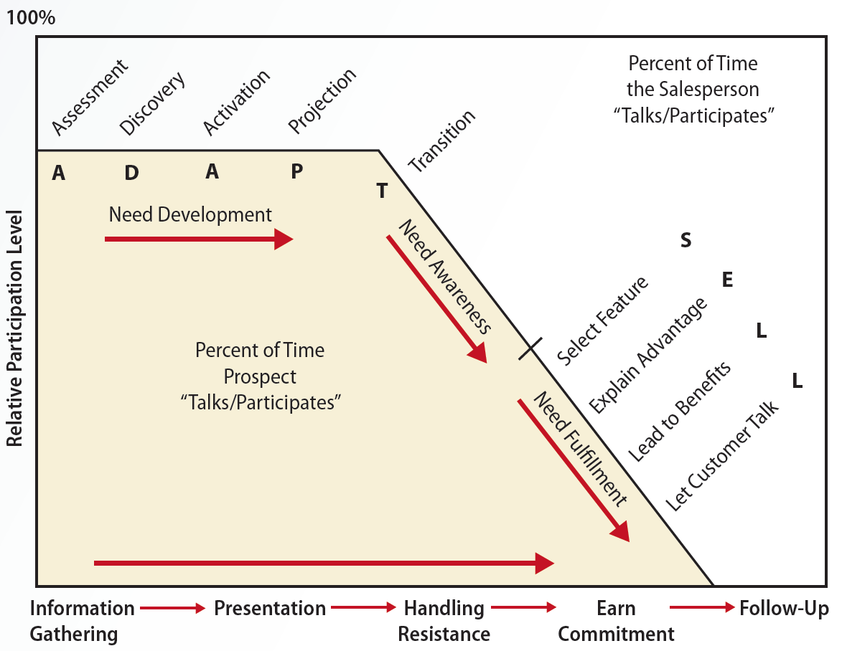
6.1 The Trust-Based Selling Process: A Need-Satisfaction Consultative Model

Slide 11
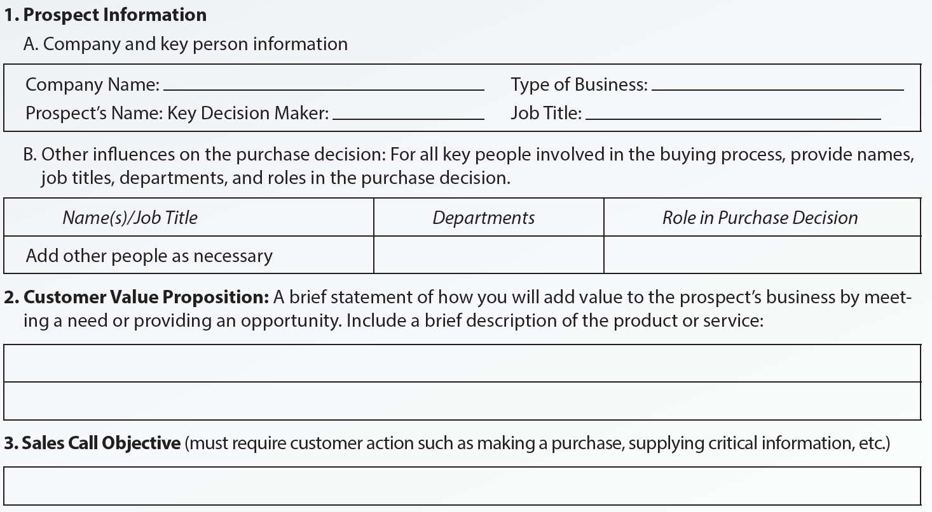
6.4 Sales Dialogue Template

Slide 12
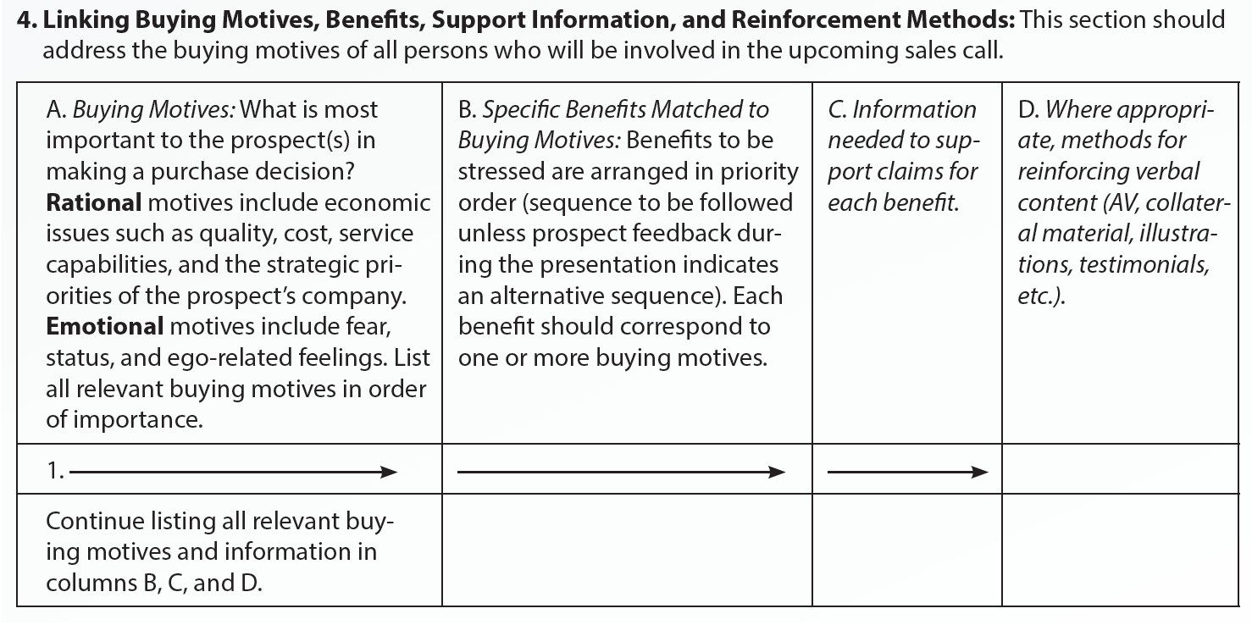
6.4 Sales Dialogue Template (continued 1)

Slide 13
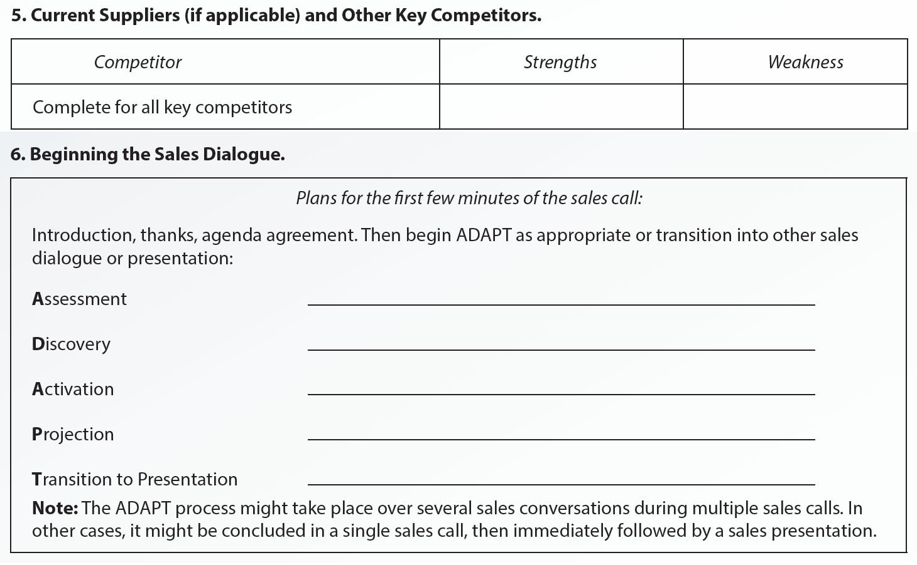
6.4 Sales Dialogue Template (continued 2)

Slide 14
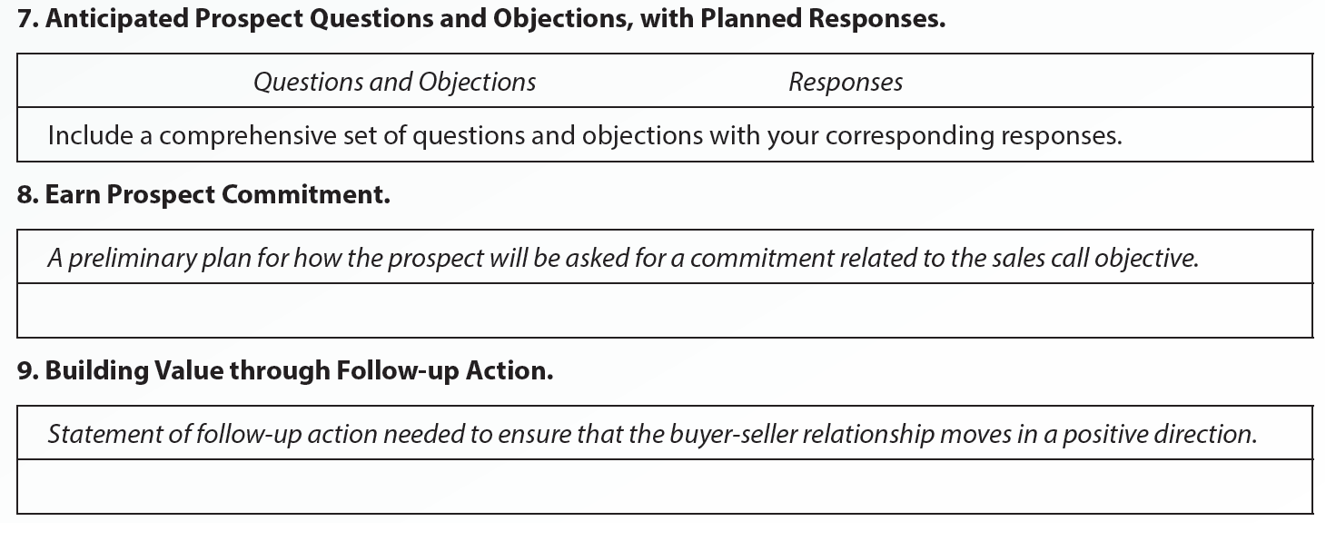
6.4 Sales Dialogue Template (continued 3)

Slide 15
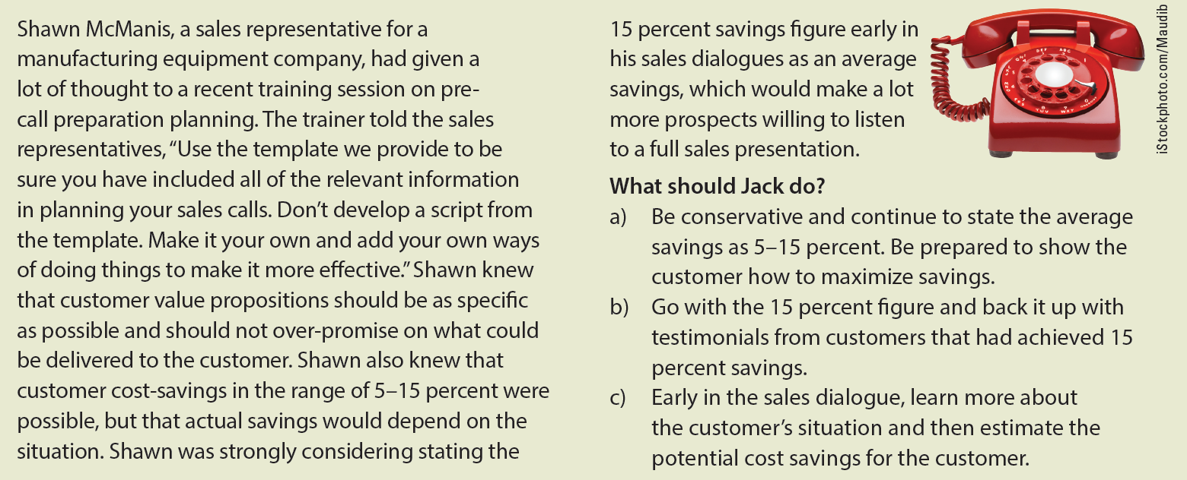
Ethical Dilemma

Slide 16
Engaging the Customer
Request an appointment
Give the prospect a reason why an appointment should be granted
Request a specific amount of time
Suggest a specific time for the appointment

Slide 17
Key Terms
Sales call
Sales dialogue
Sales presentations
Canned sales presentations
Written sales proposals
Organized sales dialogue
Organized sales presentation
Sales dialogue template
Customer value proposition
Buying motive
Rational buying motives
Emotional buying motives
Features
Benefits

Slide 18
Summary
Sales dialogue with a customer involves making a sales call and a sales presentation
Formats used in sales communication
Canned presentations, written sales proposals, and organized sales dialogues and presentations
A sales dialogue template ensure that all pertinent content areas are covered with each prospect
Engaging the prospect involves making an appointment with him or her

